Slide 1
Matlab scripts for converting to ICES data format
Emilia Lalander
2023-10-04

Slide 2
Metadata
%% Meta data
%Position data
time_period='202210';
pos_settings.position_name='Norra midsjöbanken';
pos_settings.position_id='NMS0';
pos_settings.station_code='13079';
pos_settings.tid=time_period;
pos_settings.latitud=56+04.68/60;
pos_settings.longitud=17+21.61/60;
pos_settings.measurement_height=4; %m ö botten
pos_settings.water_depth='40 m';
%% Meta data DSG010
instr_settings.instrument='Sylence';
instr_settings.instrument_id='Syl02';
instr_settings.dateformat='_yyyy-mm-dd_HH-MM-SS';%
instr_settings.manufacturer='RTsys';
instr_settings.serial='EA-SDALP_2111001 Ver3';
instr_settings.firmware='040.01.11';
instr_settings.channel=1;
instr_settings.hydrophone_manufacturer='HTI';
instr_settings.hydrophone_type='LN';
instr_settings.hydrophoneNr='785154';
instr_settings.sensitivity=-168; %Jmft med DSG013 - 2022-09
instr_settings.gain=0;
instr_settings.volt_correction=2.5;
instr_settings.setups='Autonomous';
instr_settings.decoupling='Yes'; %
%%%%%
instr_settings.kalib_struct = struct( ...
'calibration_procedure', 'Comparison method', ...
'reference_frequencies_levels','1-10 kHz', ...
'calibration_file','Single value',...
'Calibration_date','2022-10-03');
First step to create a metadata script
The metadata will be combined with processed data and the ICES data
(github: https://github.com/ices-tools-prod/underwaternoise)

Slide 3
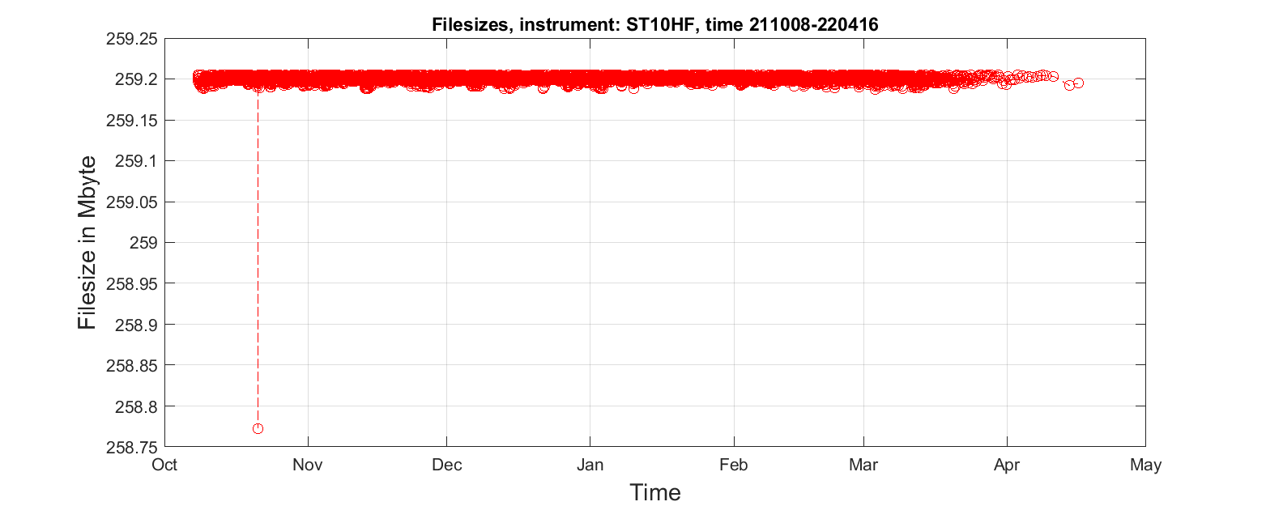
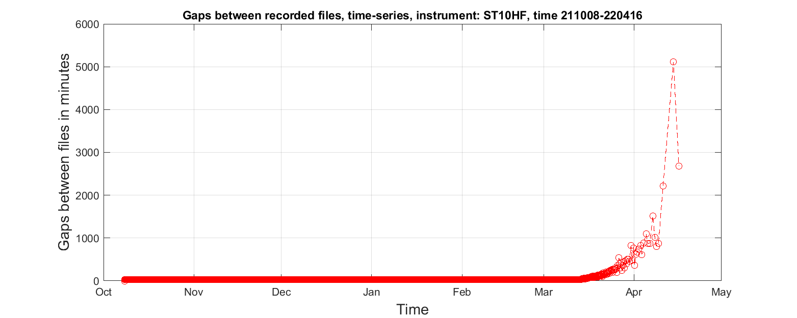
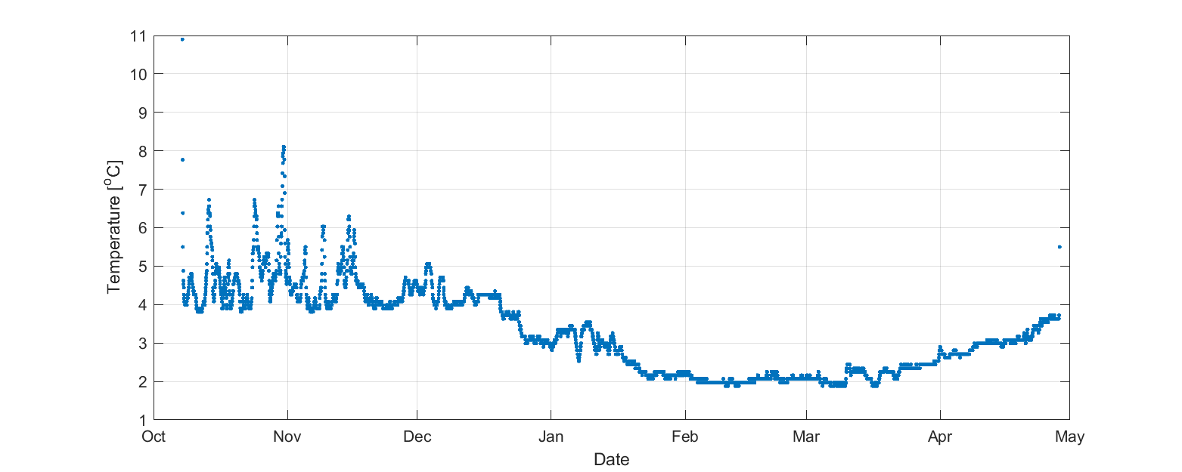
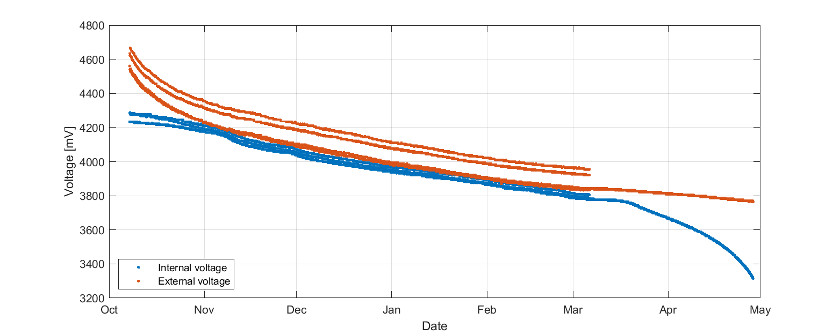
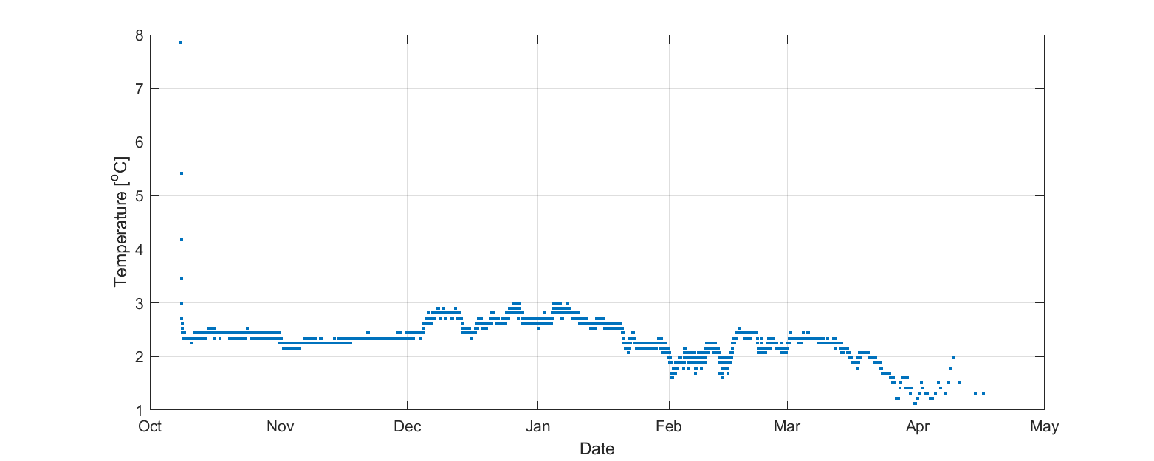
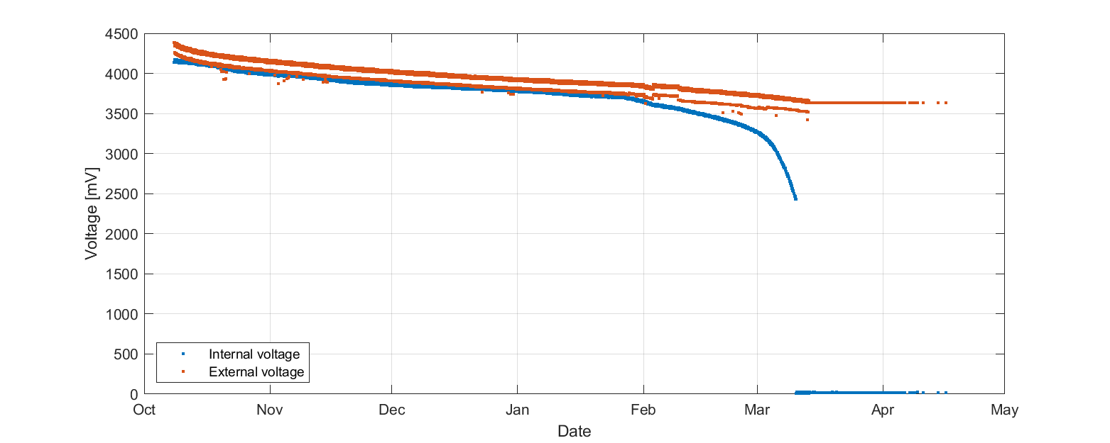
Data quality
”Clean” the dataset before processing begins
Check gaps between files and filesize (originates from BIAS)
Check voltage (if available)
Check temperature (if available) – lower temperature affects battery life

Slide 4
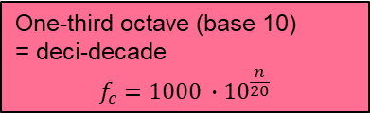
Process the data
Sensitivity and gain!! Needs to be well checked before processing
Check instrument voltage*
Process each wav file according to monitoring manuals
e.g. Jomopans: https://northsearegion.eu/media/17742/jomopans_wp3-standard-data-processing_final.pdf
Or Helcom (which is based on Jomopans): https://helcom.fi/wp-content/uploads/2019/08/Guidelines-for-monitoring-continuous-noise.pdf
*Rtsys-systems such as Sylence uses +- 2.5 V which is normalised to +-1 in Matlab
One-third octave (base 10)
= deci-decade
$$f_{c}=1000 ∙{10}^{\frac{n}{20}}$$

Slide 5
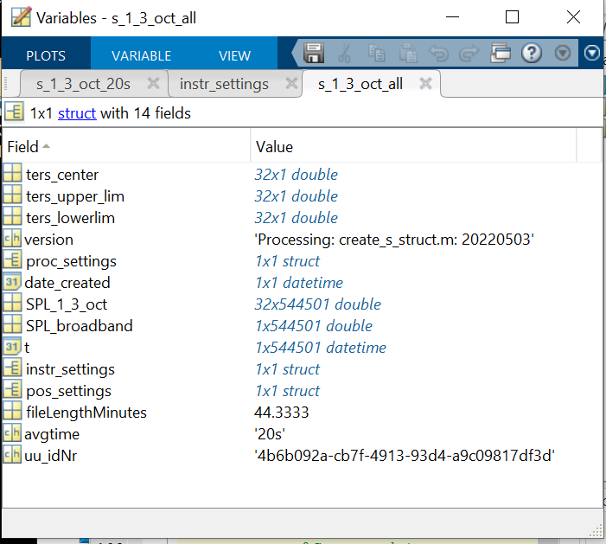
Process the data
Combine all processed files to one struct for the deployment period – add metadata
Need to add
version of processing software
UU-id number: =char(java.util.UUID.randomUUID)

Slide 6

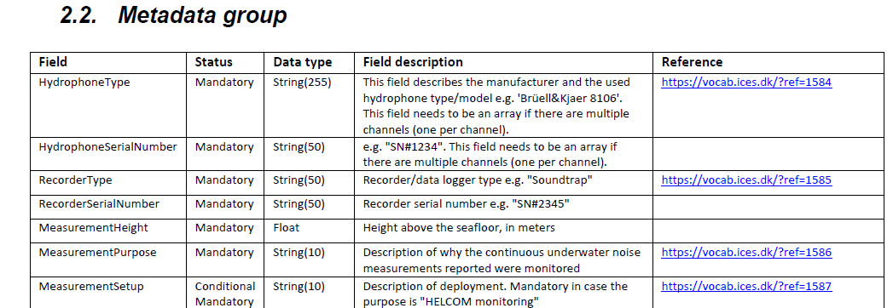
Convert to ICES struct
Check out the ICES format. READ CAREFULLY

Slide 7
Use available scripts
…assuming the data is in the format as the example ”s_NMS0_Syl02_20221022_20221107_20s.mat”
…and metadata is according to example
Run ”main_ices_hdf5_struct.m”
It will use a few other scripts also
Run_write_to_ices – reads data and metadata
Create_struct_hdf5_ices – use data to create the hdf5 struct
Matlab_write_recursive_hdf5 – write to hdf5
Etc…

Slide 8
Uploading data to ICES database
Change program to R (install R and Rstudio)
Use file continuousUWNoise_api_Emilia
It will use the functions in continuousUWNoise_api_functions
You need your token and user name
Copy this to Rstudio:
Run each line by ..
## Change user, add you username instead of Lalander:
user <- "lalander"
## Gets javascript web token
jwt <- token(user)
#passwd: XXXXXXXXXXXXXXXXXXX
## Find you files in the path: path_to_file
files <- list.files(path = “path_to_file/",pattern = "^(.*)h5$",full.names = TRUE)
## Display your files:
files
##Upload the files you want (changer number in the bracket)
lapply(files[1], UploadFile, jwt = jwt)

